Slide 1
DIFUZE: Interface Aware Fuzzing for Kernel Drivers
ACM CCS 2017
Oct 30th–Nov 3rd, Dallas, USA
Jake Corina Aravind Machiry Christopher Salls Yan Shoshitaishvili
Shuang Hao Christopher Kruegel Giovanni Vigna
Jingtang Zhang
2019.09

Slide 2
Drivers
Part of OS kernel
Operate or control a particular type of device that is attached to a computer

Slide 3

Drivers
Part of OS kernel
Operates or controls a particular type of device that is attached to a computer
Command
CPU
(drivers)
Controller
Devices
Interrupt

Slide 4
Drivers
Part of OS kernel
Customization
Monolithic OS
80% bugs of Android kernel

Slide 5
POSIX standard
Portable OS Interface for Computing Systems
int ioctl(int fd, int cmd, …);
Fuzzer
open(…)
rand(…)
…
Notes:
从源代码级别上在多种 OS 上运行

Slide 6




Issues
int ioctl(int fd, int cmd, …);
Complex
Non-structured
Non-standard
record
struct1 {
……
};
setting
struct2 {
……
};
……
struct3 {
……
};
……
struct4 {
……
};
……

Slide 7
DIFUZE
int ioctl(int fd, int cmd, …);
record
struct1 {
……
};
setting
struct2 {
……
};
……
Kernel source code
struct3 {
……
};
?
……
struct4 {
……
};
……
……

Slide 8
DIFUZE
User Space
int ioctl(int fd, int cmd, …);
register(“dev1”, &ioctl_handler1);
register(“dev2”, &ioctl_handler2);
ioctl_handler1(cmd, …) {
…
}
ioctl_handler2(cmd, …) {
…
}
Kernel
dev1
dev2

Slide 9
DIFUZE – Handler Identification
Source code
register(“dev1”, &ioctl_handler1);
Block device
Character device
Proc device
…
LLVM Compiler
…
int ioctl(int fd, int cmd, …);

Slide 10
DIFUZE – Command Determination
Equality constraints
ioctl_handler(int cmd, …) {
switch (cmd) {
case 0x1001:
…
if (cmd == 0x1001) {
…
}
…
case 0x1002:
…
}
}
int ioctl(int fd, int cmd, …);

Slide 11
DIFUZE – Argument Type Identification
struct {
…
}
Transfer function
User Space
int ioctl(int fd, int cmd, struct *);
…
copy_from_user(k_ptr, u_ptr, sizeof(*k_ptr));
…
Kernel Space
struct {
…
}

Slide 12
DIFUZE – Argument Type Identification
Equal constraint on the path to transfer function
ioctl_handler(int cmd, …) {
switch (cmd) {
case 0x1001:
…
copy_from_user(…);
…
case 0x1002:
…
}
}
int ioctl(int fd, int cmd, …);

Slide 13
DIFUZE
int ioctl(int fd, int cmd, …);
0x1001
struct1 {
……
};
“dev/dev1”
0x1002
struct2 {
……
};
“dev/dev2”
……
struct3 {
……
};
?
“dev/…”
……
struct4 {
……
};
“…”
……
……

Slide 14

DIFUZE
int ioctl(int fd, int cmd, …);
Device File
Kernel
Source Code
Command
Input
Arguments
Analysis Host
Target Host
Heart Beats
Reproduce
Restart

Slide 15
Results
Syzkaller
(without interface information)
DIFUZE
(interface-aware)
0 bugs
36 bugs

Slide 16
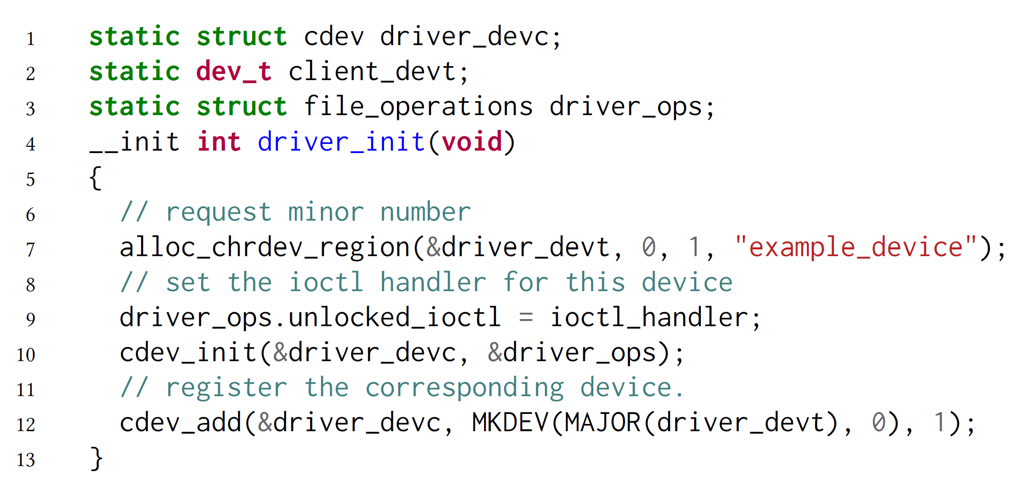
Weaknesses
Dynamically generated device name

Slide 17
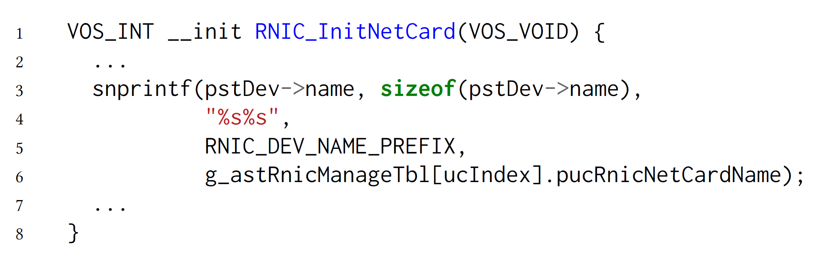
Weaknesses
Dynamically generated device name

Slide 18
Weaknesses
Inability to extract complex relationships between fields of structures
struct args {
……
char *buffer;
int buffer_len;
……
};

Slide 19
DIFUZE: Interface Aware Fuzzing for Kernel Drivers
ACM CCS 2017
Oct 30th–Nov 3rd, Dallas, USA
Thanks.

